Slide 1
Session outline
What is Linux?
Linux Shell, Access and Linux File system structure
Basic Linux/ Unix commands
Top 50 command used in Linux
Changing file permissions and ownership
Filter commands/ Simple filter and advance filter commands.
Start and Stop services
Working with Environment Variables
Find and kill the process with id and name
Package installation using RPM and YUM
Shell scripts

Slide 2
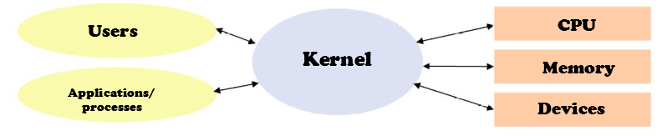
What is Linux
Linus Torvalds, in 1991 Released the first version of his Linux Kernel.
Operating system “kernel” is the core software used to communicate with computer hardware. It’s a core and modular system of drivers used to create a Resource manager for allocating memory and time to system and user processes as well as interacting with files (I/O)
Kernel operates in its own memory or “kernel-space”.

Slide 3
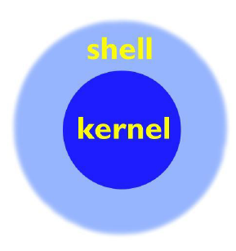
Linux Shell
On user log-in, the system runs a shell
A shell is the environment within which you will interface with the kernel via commands.
It determines the syntax for complex command-line operations and shell scripting.
The shell you’re using is called “bash,” the successor to the venerable “Bourne Shell” called “sh”
BASH: “Bourne Again SHell”

Slide 4
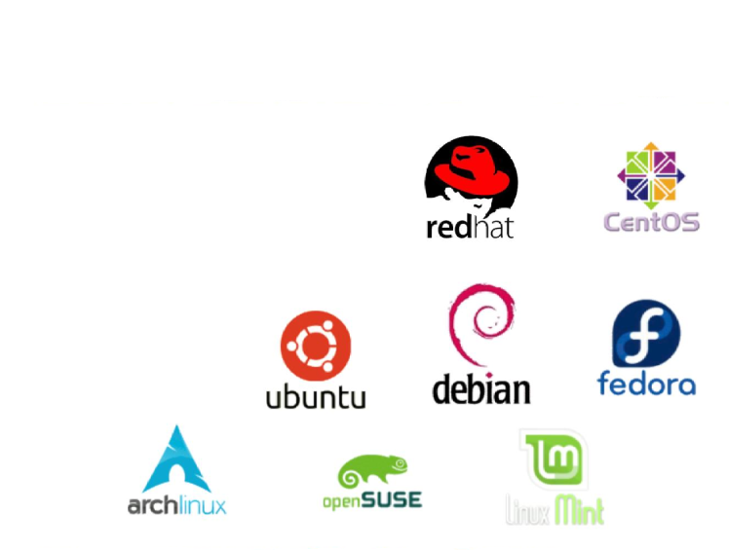
Popular Linux Distributions
Red Hat Enterprise Linux
Ubuntu
Fedora
Amazon Linux
SUSE/ SUSE Enterprise Linux
CentOS
Debian
Arch Linux

Slide 5
Linux Accounts & Access
To access a Linux system, you need to have an account. A Linux account includes the following:
- username and password
- uid and gid
- a home directory, which is where you are placed by default when you log in
- a default shell
Introducing OpenSSH
SSH is the “Secure Shell”
SSH supports a file-transfer subsystem – scp
SSH is used to remotely login to a Linux server.
Command to connect a server with IP 192.168.1.1
ssh <username>@192.168.1.1

Slide 6
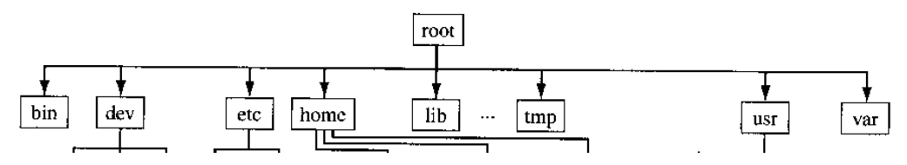
The File System
Linux and Unix-like file systems are arranged in a tree structure, all with the same bottom level, called “root” (/).
Linux Directory Structure
/ root
/bin bare essential commands
/boot OS Kernels
/dev hardware devices
/etc system files, configuration
/home home directories
/lib Libraries needed by the system
/opt 3rd party applications
/proc Running processes
/sbin administrative commands
/tmp temporary space
/usr operating system applications
/var Logs, databases and other stuffs

Slide 7
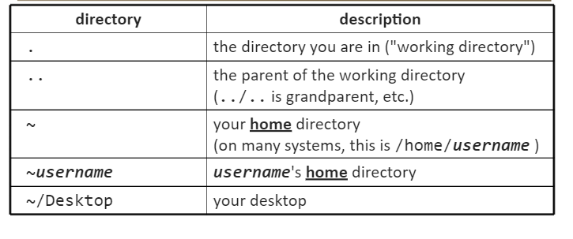
Navigating File System

